Slide 1

ECE 281 Lesson 6
Maj Kevin Walchko
1

Slide 2
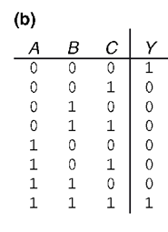

Multiplexers
Implement the following using
An 8:1 mux
A 4:1 mux (plus an inverter for TT)
A 2:1 mux (plus 2 other gates for TT; plus OR and inv for eqn)

Slide 3
K-map Example
You can wrap around all 4 corners, but not needed in this case
A | B | C | D | F
0 | 0 | 0 | X | 1
0 | 0 | 1 | 0 | 1
0 | 0 | 1 | 1 | X
0 | 1 | 0 | 0 | X
0 | 1 | 0 | 1 | 0
0 | 1 | 1 | X | 0
1 | 0 | 0 | 0 | 1
1 | 0 | 0 | 1 | X
1 | 0 | 1 | X | 1
1 | 1 | 0 | 0 | 0
1 | 1 | 0 | 1 | 1
1 | 1 | 1 | X | 1
 | CD
AB |  | 00 |  | 01 |  | 11 |  | 10
 | 00 | 0 |  | 1 |  | 3 |  | 2
 |  | 1 |  | 1 |  | X |  | 1
 | 01 | 4 |  | 5 |  | 7 |  | 6
 |  | X |  | 0 |  | 0 |  | 0
 | 11 | 12 |  | 13 |  | 15 |  | 14
 |  | 0 |  | 1 |  | 1 |  | 1
 | 10 | 8 |  | 9 |  | 11 |  | 10
 |  | 1 |  | X |  | 1 |  | 1
Note: the X’s (don’t care) makes this table shorter
F = B’+AC+AD

Slide 4
K-map Example
F(A, B, C, D) = ∑(0,2,4, 6, 7, 8, 10, 11, 12, 15)
don’t care ∑(14)
 | CD
AB |  | 00 |  | 01 |  | 11 |  | 10
 | 00 | 0 |  | 1 |  | 3 |  | 2
 |  | 1 |  | 0 |  | 0 |  | 1
 | 01 | 4 |  | 5 |  | 7 |  | 6
 |  | 1 |  | 0 |  | 1 |  | 1
 | 11 | 12 |  | 13 |  | 15 |  | 14
 |  | 1 |  | 0 |  | 1 |  | X
 | 10 | 8 |  | 9 |  | 11 |  | 10
 |  | 1 |  | 0 |  | 1 |  | 1
F = D’+BC+AC
4

Slide 5
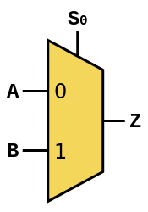
Multiplexer
Multiplexer: 2-to-1 or 2:1 shown below … basically you can switch between different inputs
Example: I have 2 binary sensors (True/False) but only one input pin available to my processor, this allows me to connect to more inputs (this is a silly example at 2:1). 8:1 mux costs me 3 address lines and 1 input pin (4 pins total, but I can read 8 things) … better example.
You can also see this
S | B | A | Z
0 | 0 | 0 | 0
0 | 0 | 1 | 1
0 | 1 | 0 | 0
0 | 1 | 1 | 1
1 | 0 | 0 | 0
1 | 0 | 1 | 0
1 | 1 | 0 | 1
1 | 1 | 1 | 1
 | BA
 | S | 00 |  | 01 |  | 11 |  | 10
 | 0 | 0 |  | 1 |  | 3 |  | 2
 |  | 0 |  | 1 |  | 1 |  | 0
 | 1 | 4 |  | 5 |  | 7 |  | 6
 |  | 0 |  | 0 |  | 1 |  | 1
D₀
D₁
Z = S’A+SB

Slide 6
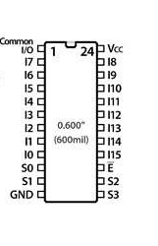
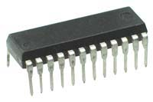
74HC4067 16:1 Multiplexer
output
We will eventually building this chip in software using VHDL
Inputs 0-7
Inputs 8-15
Selection bits
Selection bits

Slide 7
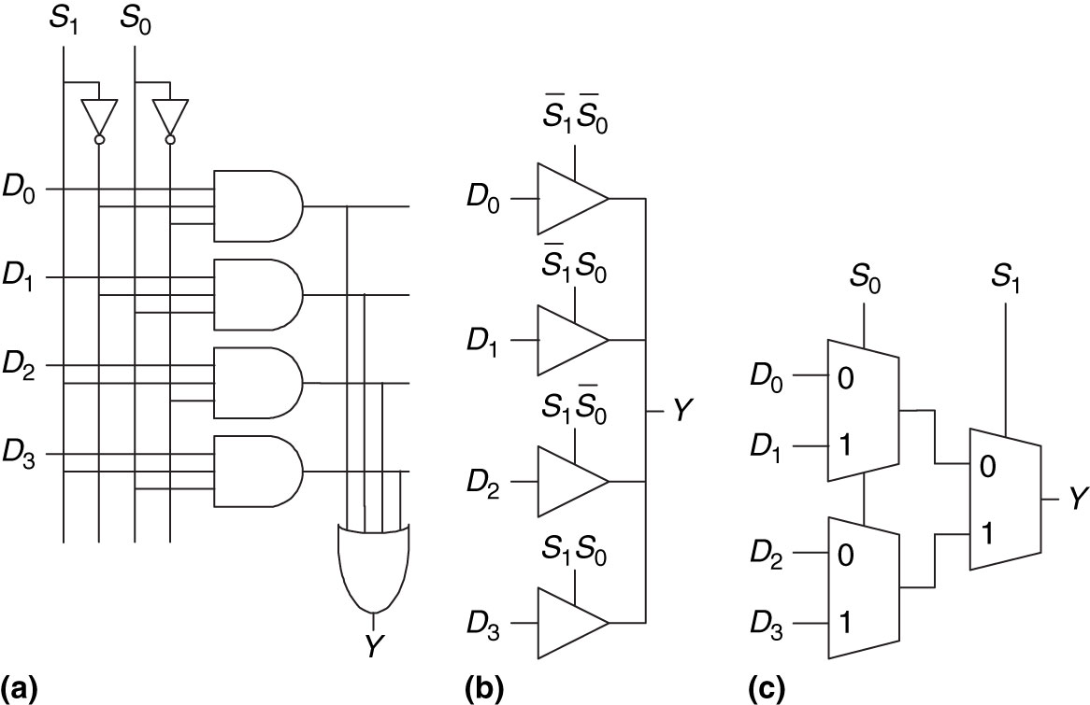
Multiplexers
Figure 2.58 4:1 multiplexer implementations: (a) two-level logic, (b) tristates, (c) hierarchical

Slide 8
Multiplexers
Implement the following using
An 8:1 mux
A 4:1 mux (plus an inverter for TT)
A 2:1 mux (plus 2 other gates for TT; plus OR and inv for eqn)
A | B | C | Y
0 | 0 | 0 | 1
0 | 0 | 1 | 0
0 | 1 | 0 | 1
0 | 1 | 1 | 1
1 | 0 | 0 | 0
1 | 0 | 1 | 0
1 | 1 | 0 | 1
1 | 1 | 1 | 1

Slide 9
8:1 Mux
ABC
A | B | C | Y
0 | 0 | 0 | 1
0 | 0 | 1 | 0
0 | 1 | 0 | 1
0 | 1 | 1 | 1
1 | 0 | 0 | 0
1 | 0 | 1 | 0
1 | 1 | 0 | 1
1 | 1 | 1 | 1
VCC
3
000
001
010
011
100
101
110
111
Y
If an Y is 1, then it is connected to VCC and if Y is 0, then it is connected to GND.
GND

Slide 10
4:1 Mux
A | B | C | Y
0 | 0 | 0 | 1
0 | 0 | 1 | 0
0 | 1 | 0 | 1
0 | 1 | 1 | 1
1 | 0 | 0 | 0
1 | 0 | 1 | 0
1 | 1 | 0 | 1
1 | 1 | 1 | 1
VCC
A
BC
B | C | Y
0 | 0 | A’
0 | 1 | 0
1 | 0 | 1
1 | 1 | 1
2
00
01
10
11
Y
GND
We can simplify this down by removing the MSB and looking at the other remaining inputs. There is a pattern we can exploit.

Slide 11
2:1 Mux
Original
A | B | C | Y
0 | 0 | 0 | 1
0 | 0 | 1 | 0
0 | 1 | 0 | 1
0 | 1 | 1 | 1
1 | 0 | 0 | 0
1 | 0 | 1 | 0
1 | 1 | 0 | 1
1 | 1 | 1 | 1
VCC
A
C
B
B | C | Y
0 | 0 | A’
0 | 1 | 0
1 | 0 | 1
1 | 1 | 1
1
B | Y
0 | A’C’
1 | 1
0
1
Y
Now looking at the 4:1 TT, we see B follows Y closer than C, so let’s remove C.

Slide 12
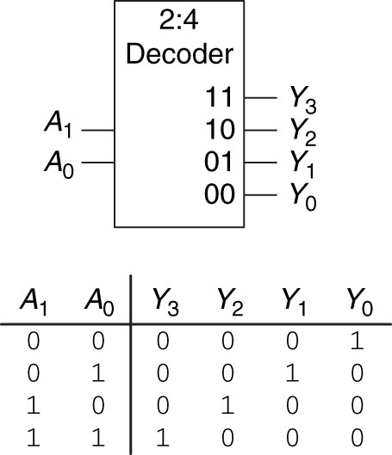
Decoder
Figure 2.63 2:4 decoder

Slide 13
2:4 Decoder - VHDL
library IEEE;
use IEEE.STD_LOGIC_1164.ALL;
entity decode_2to4 is
Port (A : in STD_LOGIC_VECTOR (1 downto 0); -- 2-bit input
EN : in STD_LOGIC; -- enable input
Y : out STD_LOGIC_VECTOR (3 downto 0)); -- 4-bit output
end decode_2to4;
architecture Behavioral of decode_2to4 is
begin
Y(0) <= '1' when A = "00" else
'0';
Y(1) <= '1' when A = "01" else
'0';
Y(2) <= '1' when A = "10" else
'0';
Y(3) <= '1' when A = "11" else
'0';
end Behavioral;
Import libraries
Define ports
code
Just like the Mux, we can do a decoder in VHDL

Slide 14
Delays
Why are there delays in a circuit?
Capacitive Charging
Speed of light
Temperature
Many inputs/outputs
Measured in ps or ns
Often listed on datasheets

Slide 15
Vocabulary
Rising Edge – transition from low to high
Falling Edge – transition from high to low
Propagation Delay (t_{pd}) – max time from when input changes to when output reaches final value
Contamination Delay (t_{cd}) – min time from when input changes to when output starts changing
Critical Path – longest (slowest) path from an input to an output (i.e. Circuit t_{pd})
Short Path – shortest (fastest) path from an input to an output (i.e. Circuit t_{cd})
Glitch – Single input transition that causes multiple output transitions.

Slide 16
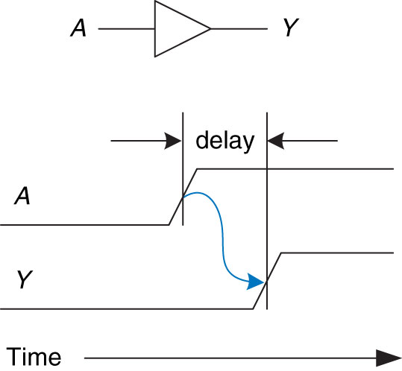
Delay
Figure 2.66 Circuit delay

Slide 17
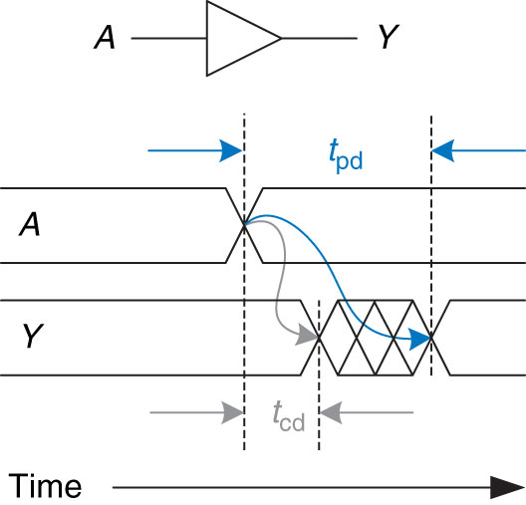
Propagation Delay and Contamination Delay
Figure 2.67 Propagation and contamination delay

Slide 18
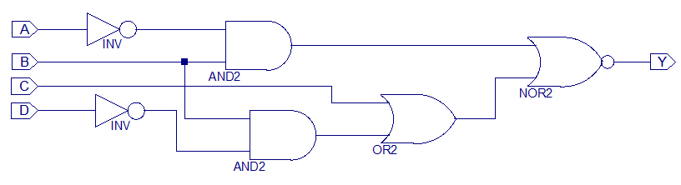
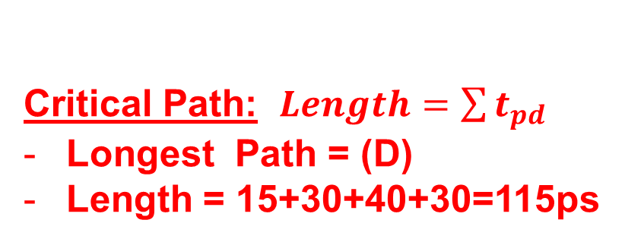
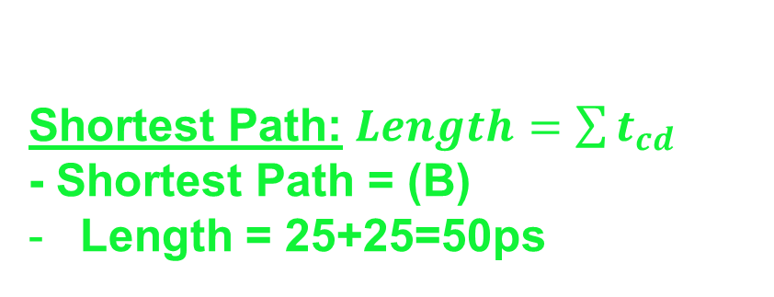
Delay – Example 1
25
25
30
40
30
15
Critical Path: $Length=\sum{t_{pd}}$
Longest Path = (D)
Length = 15+30+40+30=115ps
 | t_{pd} (ps) | t_{cd} (ps)
_{NOT} | ₁₅ | ₁₀
_{AND} | ₃₀ | ₂₅
_{OR} | ₄₀ | ₃₅
_{NOR} | ₃₀ | ₂₅
Shortest Path: $Length=\sum{t_{cd}}$
- Shortest Path = (B)
Length = 25+25=50ps

Slide 19
Glitch
We expect a valid output between 50ps and 115ps
What happens between 50ps and 115ps?
Glitch – Single input transition that causes multiple output transitions.
Let’s see it in action

Slide 20
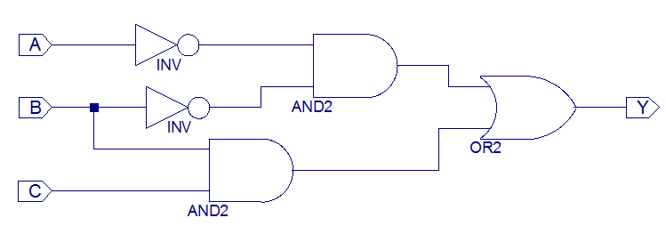
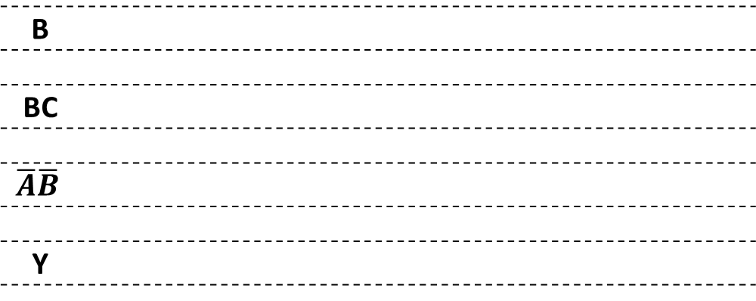
Delay – Example 2 - Glitches
0
1
0
1
A’B’
1
➔0
0
1
1
0-1
1
0
1
1
0
BC
B
BC
$$\overline{A}\overline{B}$$
Y
AND gates are slower
Both inputs to Y are now 0, so Y changes to 0
Now one of them is 1, so Y heads back to 1

Slide 21


Delay – Example 2 - Glitches
To fix the glitch we can just circle the transition point and add another term and it only costs us a little circuitry.
 | BA
 | S | 00 |  | 01 |  | 11 |  | 10
 | 0 | 0 |  | 1 |  | 3 |  | 2
 |  | 1 |  | 1 |  | 1 |  | 0
 | 1 | 4 |  | 5 |  | 7 |  | 6
 |  | 0 |  | 0 |  | 1 |  | 0
$$Y=\overline{A}\overline{B}+BC$$
$$Y=\overline{A}\overline{B}+BC+\overline{A}C$$

Slide 22
Glitches
Do we like fixing glitches?
No, not really
Plus, you may not fix all glitches
Simultaneous transition on multiple inputs can cause glitches that can’t be solved by hardware
How do we eliminate glitches?
Calculate all propagation delays for a circuit and ensure we don’t expect the result before this time.
Often we will create a synchronous circuit (something we will learn later) with a register to store the result when it is available
Problem 2.29 from Homework…are there glitches???

Slide 23

23

Slide 24
Lesson 6 Outline
Do Time Logs!
Homework from last time:
Problems 2.41 and 2.42
Review K-Maps, Multiplexers, and Decoders
Delays
Critical Path
Glitches
Due Next Time:
CE2
HW2 (Pre-ICE)

Slide 25
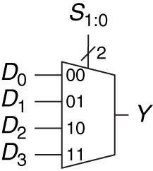
4:1 Mux - VHDL
library IEEE; -- These lines are similar to a #include in C
use IEEE.STD_LOGIC_1164.ALL;
entity mux_4to1 is
Port ( SEL : in STD_LOGIC_VECTOR (1 downto 0);-- select input
D : in STD_LOGIC_VECTOR (3 downto 0); -- inputs
Y : out STD_LOGIC);
end mux_4to1;
architecture Behavioral of mux_4to1 is
begin
-- These statements are called concurrent signal assignments.
-- They all happen at the same time unlike a regular programming language
Y <= D(0) when (SEL = "00") else
D(1) when (SEL = "01") else
D(2) when (SEL = "10") else
D(3) when (SEL = "11") else A(0);
end Behavioral;
CE 2 will start to introduce you to VHDL
Figure 2.57 4:1 multiplexer

Slide 26
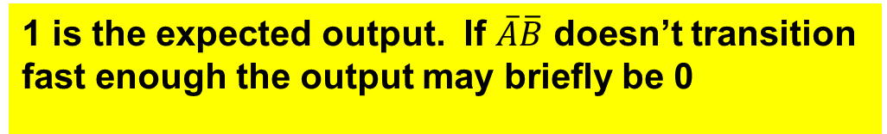
Delay – Example 2 - Glitches
0
1➔0
1
1
B
BC
$$\overline{A}\overline{B}$$
Y
1 is the expected output. If $\overline{A}\overline{B}$ doesn’t transition fast enough the output may briefly be 0

